Slide 1

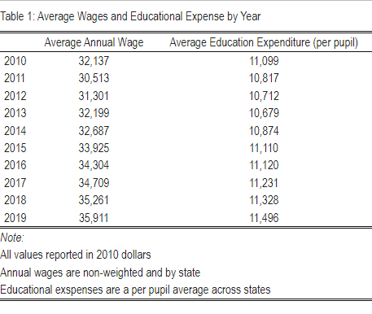
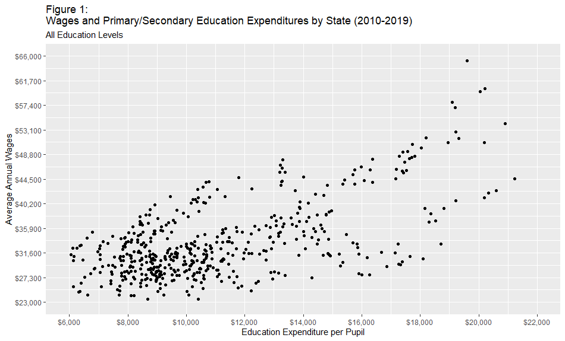
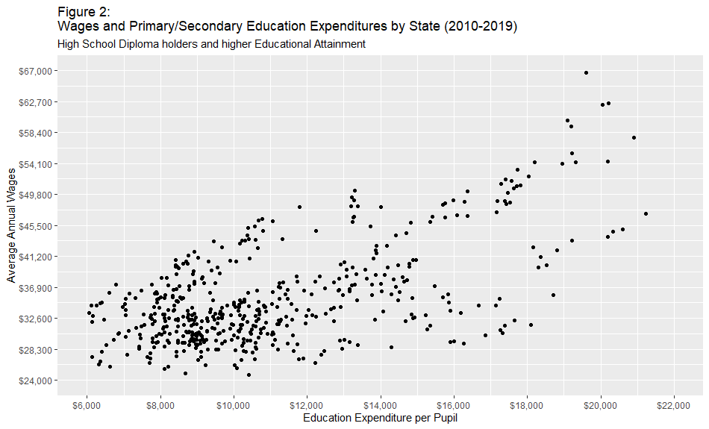
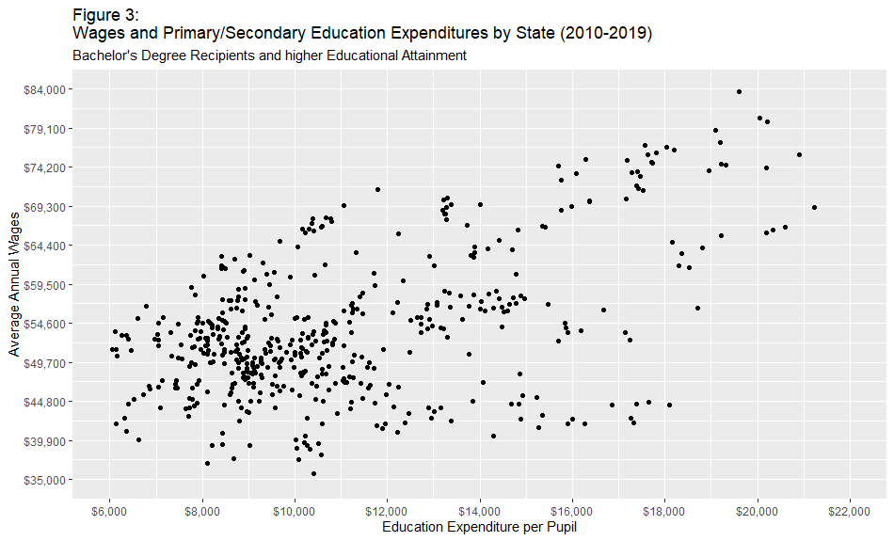
Education Spending and Annual Wages 2010-2019
Devan Arnold
University of Maine School of Economics
Introduction
Tables and Figures
Discussion
Discussion, Cont.
Educational attainment plays an important role in the development of human capital and is positively associated with indicators such as lifetime earnings and economic mobility. This research is intended to further study education and the relationship it has with earnings. Specifically, we want to know: what is the relationship between state primary and secondary spending and the annual wages of workers?
There are two primary variables of interest – annual wages and state spending on primary and secondary education. The former data regarding wages was obtained from the United State Census Bureau’s American Community Survey (ACS) from the year 2010 to the year 2019. This data was then categorized based on state, year, classification of worker, and educational attainment. This resulted in 127,500 unique combinations that were then appended to include average annual wage among those meeting the criteria for each combination, total annual wage of the categorical combination, and the number of observations from the ACS data that match the categorical combination. The second variable, state spending on primary and secondary education, was obtained from the National Center for Education Statistics. This data set consists of the per pupil educational spending by state for the years 2010 to 2019.
Together these data sets are used to create a 510-observation data set with categorical variables of state and year to allow for the comparison of annual wages and state education spending. To facilitate this, we converted all dollar values to 2010 dollars to allow for direct comparison of terms. In addition, since we already know the educational attainment and worker classification for all possible categories, we can filter the data we wish to analyze to compare the relationship of education spending and wages under different categorical conditions.
First, we will briefly describe the table and figures included here with our research. Table 1 shows the national average annual wage and the average per pupil annual education expenditure in 2010 dollars. This table is not the most informative informational tool we’ve included here, but it does show that the average per pupil rate of education spending has stayed relatively flat in terms of real dollars for our period of study. That said, there is evidence that both education spending and average annual wages rose over the study period. However, the method of calculation of the national average wage is likely to be biased, as it is reflecting the average of state weighted averages. Thus, these values may not accurately represent the national average annual wages by year as well as a person weighted average would.
More interesting are the figures resulting from our data sets. Figure 1 shows the relationship between average annual wages and per pupil education expenditures for all education levels. From this plot we can see that there appears to be a positive correlation between education spending and wages. Figure 2 shows this relationship as well, but this time the data is conditioned on workers having at least a high school diploma (or equivalent). The relationship here appears to also have a positive correlation, and the relationship also appears to be slightly more so than that seen in Figure 1. However, the most interesting insight comes from the inclusion of Figure 3 into the mix, which shows the same relationship as figures 1 and 2, but for those individuals with at least a bachelor’s degree or higher level of educational attainment. This figure shows a relationship that, while positive as well, appears less strong than in Figure 1 or Figure 2. It is interesting that the correlation of primary and secondary education spending and annual wages is weaker the higher level of education that has been obtained, and while it would be dangerous to try to conject on the reasons why that might be it certainly speaks to the idea that education can help insulate people from societal shortcomings. Wealth would be a strong factor in that relationship undoubtedly, but this data sparks some interesting possibilities for future research.
As mentioned prior, wealth is certainly a confounding factor in the relationship. Additionally, it would be reasonable to assume that states with higher incomes, on average, would likely have higher tax revenues to allow for more spending on education. Of course, this assumes that income tax is constant from state to state, which we also know to be untrue. Ultimately, while an interesting topic of research there exists a litany of confounding factors that will make causal inference difficult to reach. The trends present in our data hint that there are interesting relationships at play in this space, but realizing those underlying relationships into strong causal claims will certainly be challenging.
References
National Center for Education Statistics. (n.d.). Common Core of Data (2010-2019) [dataset].
U.S. Bureau of Labor Statistics. (n.d.). CPI Inflation Calculator [dataset]. Retrieved October 15, 2023, from https://data.bls.gov/cgi-bin/cpicalc.pl?cost1=100.00&year1=201012&year2=201912
U.S. Census Bureau. (n.d.). American Community Survey (2010-2019) [dataset].
The University of Maine does not discriminate on the grounds of race, color, religion, sex, sexual orientation, including transgender status and gender expression, national origin, citizenship status, age, disability, genetic information, or veteran status in employment, education, and all other programs and activities. The following person has been designated to handle inquiries regarding nondiscrimination policies: Director, Office of Equal Opportunity, 101 North Stevens Hall, 581.1226, equal.opportunity@maine.edu.

